Slide 1
Instructions:
You may change these slides as you see fit. You may add or remove slides. You do not need to use this slide at all.
Notes:
Please tell us about the challenges you may have faced, what you would have done differently and how you would have solved these problems if you had more time.
Mention all design considerations and talk about why you chose to implement certain advanced features.

Slide 2
Second Wave of COVID
Pinghang Fan
pinghangfan1022@gmail.com
Notes:
Please enter project details and your details here.

Slide 3
A bit about yourself ☺
About me: Computer Science/Information System Major
Favorite thing about MSA: Free learning and opportunities to connect with employer? Why didn’t the university think of this.
Future Goals: Software Development or Data Analyst
Notes:
This section is NOT assessed. We just want to get to know you ☺.

Slide 4
The Problem
The COVID19 Pandemic has caused great disruption around the globe.
New Zealand was able to successfully eradicated it in our borders for around 3 months, however a sudden reparent has taken place on 11/8/2020.
We wanted to study the reaction from public regarding the sudden resurgence of coronavirus.
To analysis and gain insight on public mental health, consumer confidence level, and external reactions.
Notes:
User Experience

Slide 5
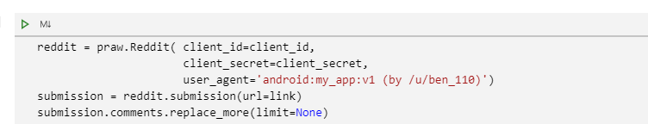
Data Extraction and Cleaning
Data was collected using PRAW with the reddit API.
Notes:
Talk about your database, what schema you used and what data you used

Slide 6
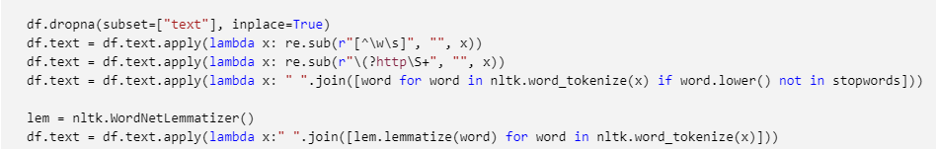
Data Extraction and Cleaning
Removing punctuations, links, and stop words
Notes:
Talk about your database, what schema you used and what data you used

Slide 7
To analysis and gain insight on public mental health, consumer confidence level, and external reactions.

Slide 8

Data Exploration
Bigrams
- Mental Health
Herd Immunity
Panic Buying
Kia Kaha
Good Luck
Notes:
Advanced features…

Slide 9
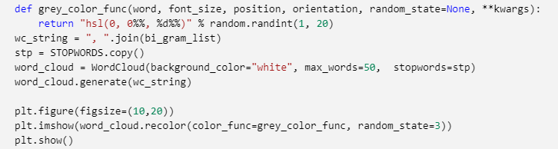
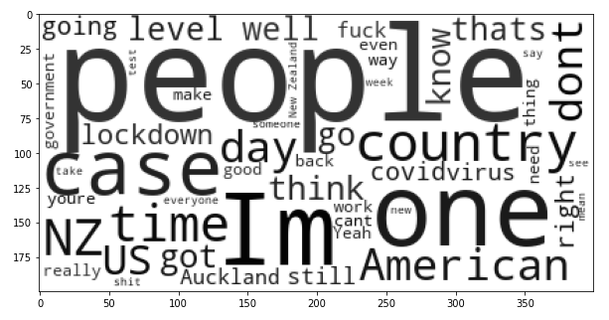
Data Exploration
Word Clouds
Notes:
Advanced features…

Slide 10
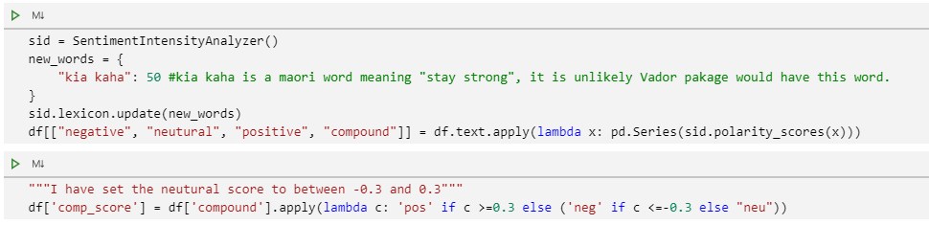
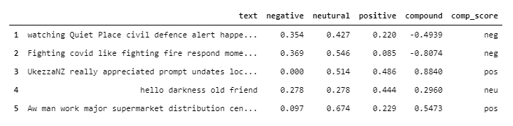
Sentiment Analysis
- Vader Package
Notes:
Explain your Azure features here

Slide 11
Kaggle Challenge
Score = 0.65433
Notes:
Advanced features…

Slide 12
Comparisons
Differences in positive vs negative
Data cleaning requirements
Notes:
Advanced considerations…

Slide 13
Thank You
Notes:
Any final things you want to tell us

